Slide 1
RTKLIB Tools Supporting Aceinna Format
2021-01-05

Slide 2
Content
what is rtklib
rtklib tools supporting Aceinna Format
aceinna data format
use strsvr to decode aceinna-user data
use rtknavi to decode aceinna-user data
use rtknavi to decode aceinna-raw data
use rtknavi to save ins2000 data and decode

Slide 3
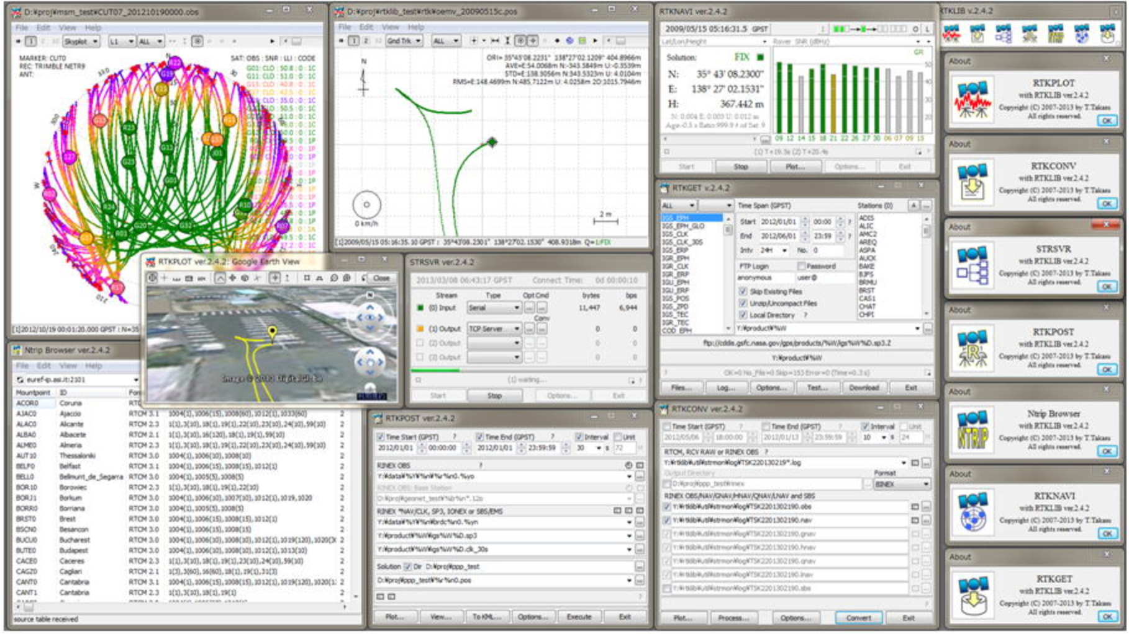
What is rtklib
rtklib is an open-source program package for standard and precise positioning with GNSS (global navigation satellite system). It supports standard and precise positioning algorithms with GPS, GLONASS, Galileo, QZSS, BeiDou and SBAS.

Slide 4
Rtklib tools supporting Aceinna Format
rtklib tools supporting aceinna format is a special version of rtklib which supports aceinna data format to display data, decode data, save data and also plotting and RTK processing.
rtklib with Aceinna format binary version:
https://github.com/Aceinna/rtklib_bin_aceinna
rtklib with Aceinna format source version:
https://github.com/Aceinna/rtklib_aceinna
A special OpenRTK330LI firmware “OpenRTK330L-GNSS_RTK_INS_NEW_DATA_FORMAT.bin”supports
new aceinna data format output. The download links is as follow
https://developers.aceinna.com/code/apps

Slide 5

Aceinna data format
Aceinna-user and aceinna-raw are two data formats exported from Openrtk330LI. The data is outputted from serial port 1 and serial port 3 of Openrtk330LI. Aceinna-user data includes imu raw data, rtk and ins solution; Aceinna-raw includes rover, base RTCM data and imu raw data.

Slide 6
Aceinna-user format
Data format definition
Description
Start: Each frame of data starts with this, 2 bytes: 0x55 0x55.
Frame type: 2 bytes, high byte first.
Data length: 1 byte, refers to the byte length of the data content.
Data content: maximum 255 bytes.
Check: crc16 check, 2 bytes, low byte first, bytes from the beginning of the “Frame type” to the end of the “Data content” are included in the check calculation, and the check algorithm C code is as follows:
Start 1 | Start 2 | Frame type 1 | Frame type 2 | Data length 1 | Data content | Check 1 | Check 2

Slide 7
Aceinna-user format
uint16_t CalculateCRC (uint8_t *buf, uint16_t length)
{
uint16_t crc = 0x1D0F;
for (int i=0; i < length; i++) {
crc ^= buf[i] << 8;
for (int j=0; j<8; j++) {
if (crc & 0x8000) {
crc = (crc << 1) ^ 0x1021;
}
else {
crc = crc << 1;
}
}
}
return ((crc << 8 ) & 0xFF00) | ((crc >> 8) & 0xFF);
}

Slide 8
Aceinna-user format
Frame types
Aceinna-user has five types of data, namely "S1", "G1", "I1", "O1" and "Y1"; For the specific structure of each type of format, please refer to the openrtk documentation：
https://openrtk.readthedocs.io/en/latest/communication_port/User_uart.html#imu-raw-data-packet

Slide 9
Aceinna-raw format
Aceianna-raw is composed of four format types of $GPGGA，$GPIMU，$GPROV，$GPREF.
$GPGGA
$GPGGA is the standard NMEA GGA format.
$GPIMU
$ GPIMU is the IMU information in NMEA format.
$GPIMU | time of week | accel-x | accel-y | accel-z | gyro-x | gyro-y | gyro-z

Slide 10
Aceinna-raw format
$GPROV
$ GPROV contains the RTCM package from Rover.
$GPBAS
$GPBAS contains the RTCM package from Base.
$ GPROV | time of week | left length | RTCM bin
$ GPBAS | time of week | left length | RTCM bin

Slide 11
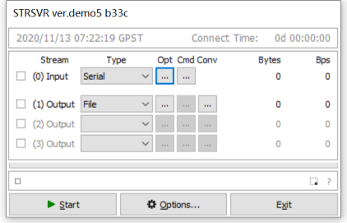
Use strsvr to decode aceinna-user data
Use strsvr to decode aceinna-user data format. Decode aceinna format data and display information in monitor dialog and save it in files.
Select serial for (0) input. Click “opt” button to open the Serial Options dialog.

Slide 12
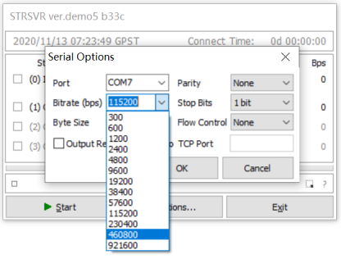
Set input stream parameter
Bitrate is selected as 460800.

Slide 13
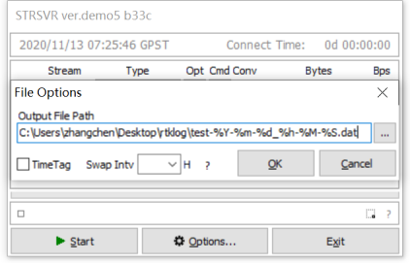
Set output files path
Select the path to save the file. For example: C:\Users\zhangchen\Desktop\rtklog\.

Slide 14
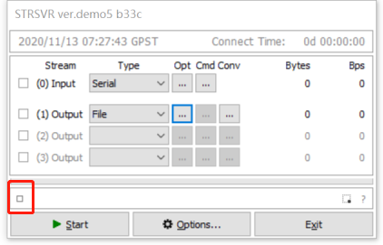
Show the data in monitor dialog and save file
Click the small square button to open Input Stream Monitor dialog.

Slide 15
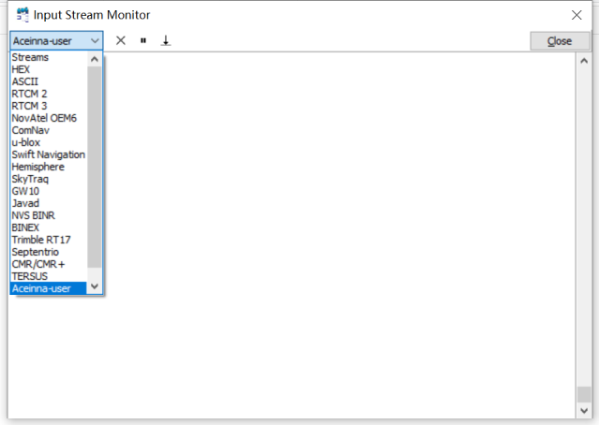
Show the data in monitor dialog and save file
Select the aceinna-user format.

Slide 16
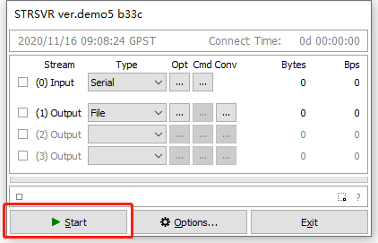
Show the data in monitor dialog and save file
Click “start” button to start receiving data.

Slide 17
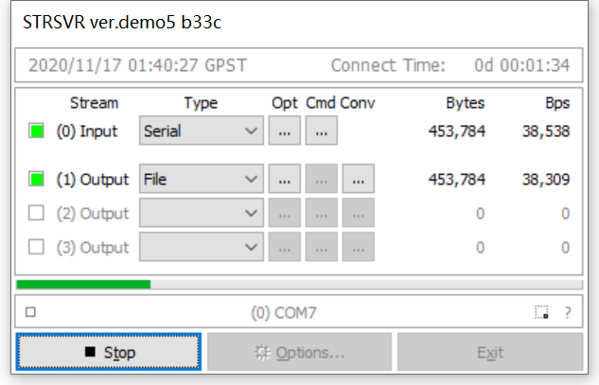
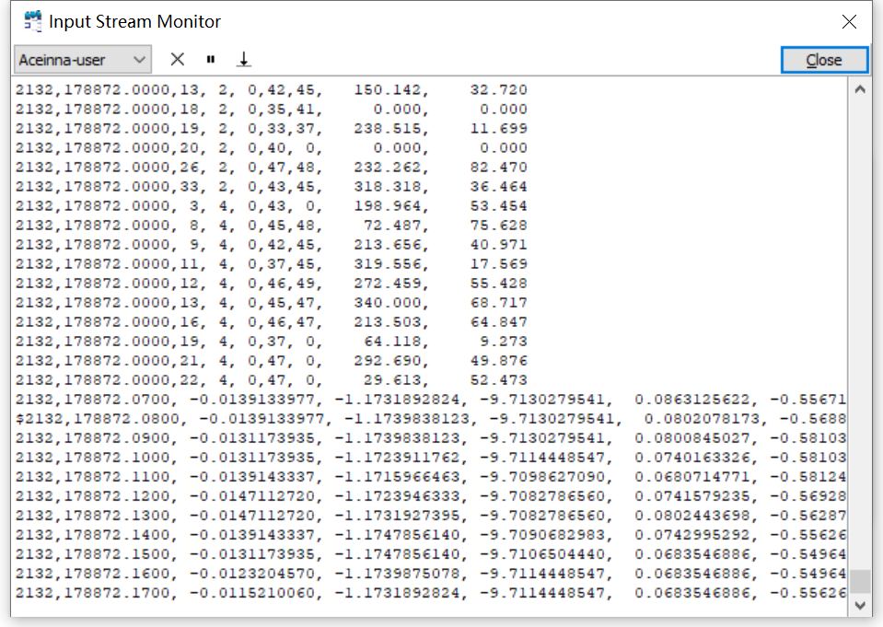
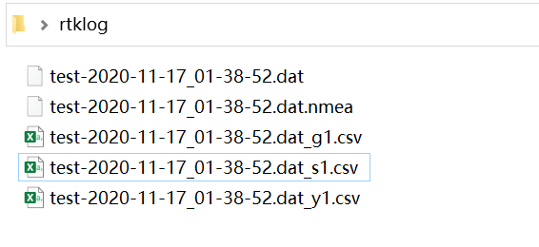
Show the data in monitor dialog and save file
Strsvr is running, the data decoding information is showed in monitor dialog. The file is saved in the previous output path

Slide 18
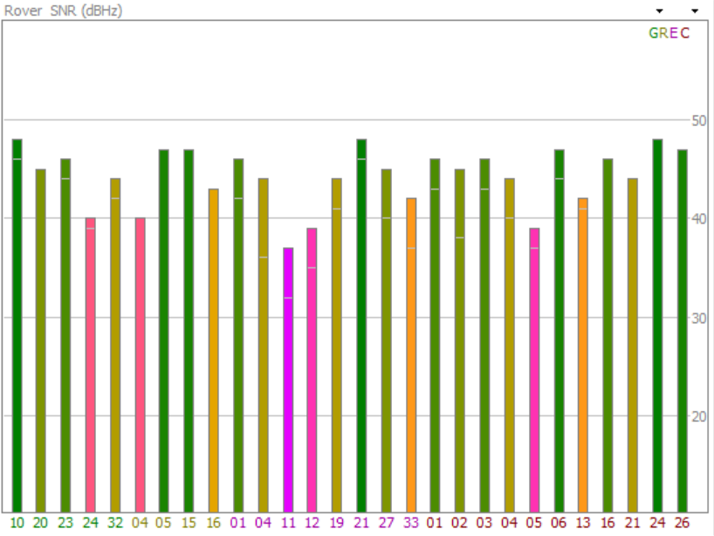
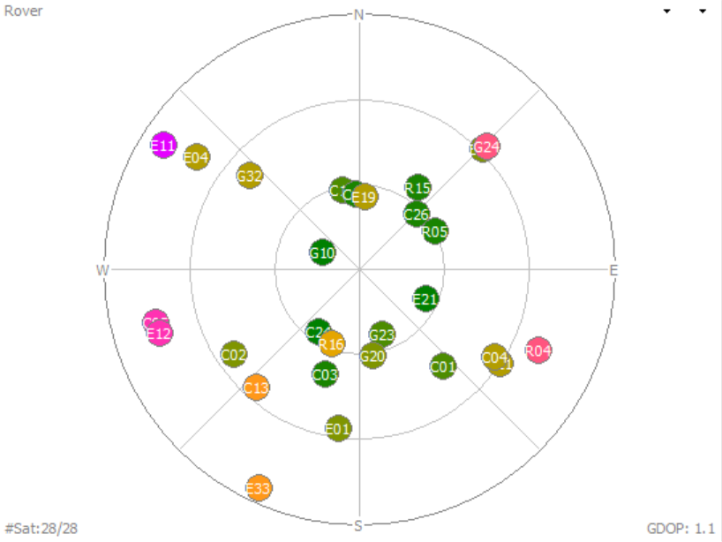
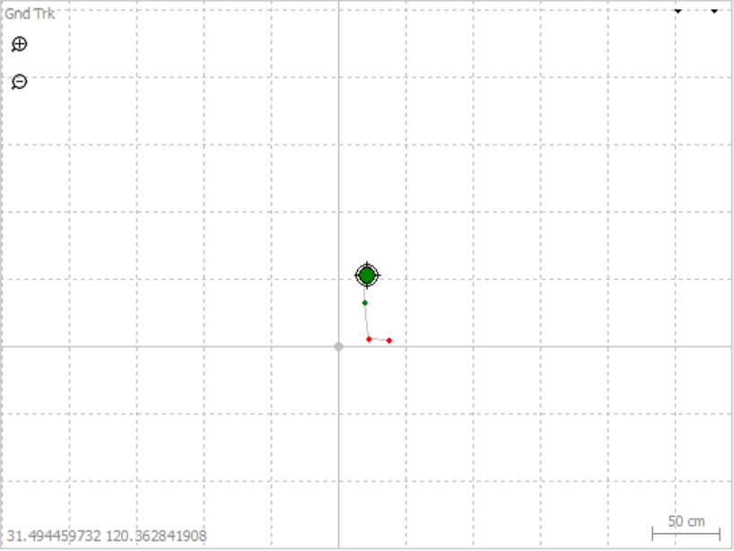
Use RTKLIBNAVI to decode aceinna-user data
Aceinna-raw data is the result output from openrtk330. Using rtklibnavi to connect the first serial port of openrtk330, the RTK processing result data can be recognized. These data can be displayed by SNR plot, sky map and GND Trk.
SNR plot, star map and GND Trk

Slide 19
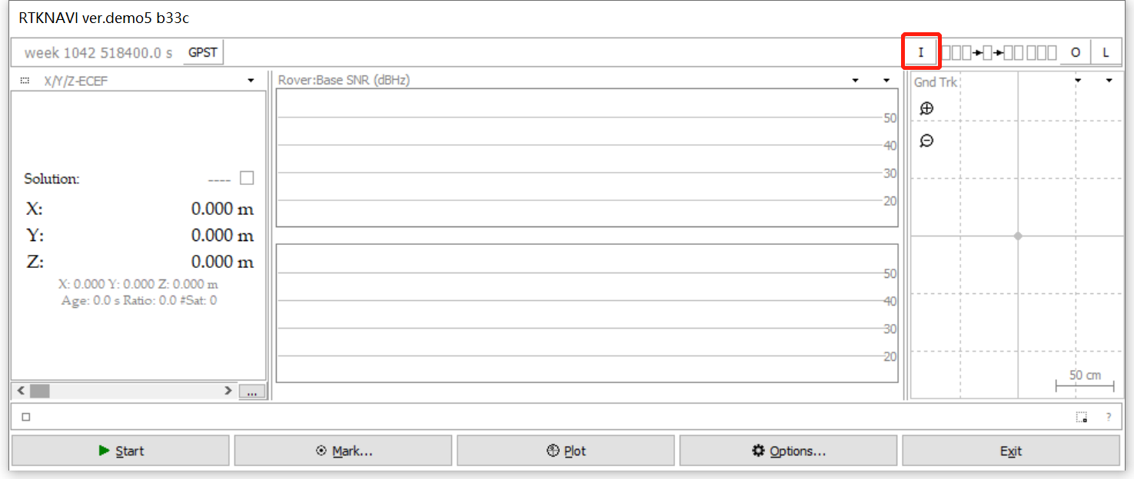
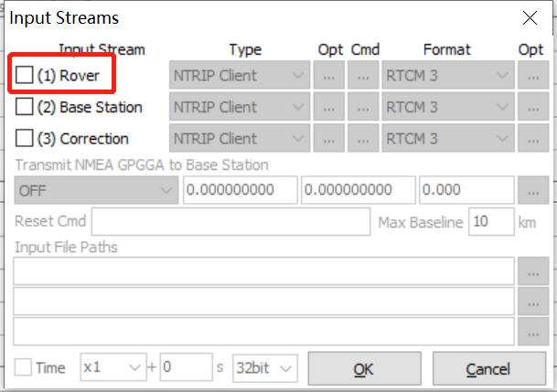
Set input stream parameter
Click the ‘I’ button to open Input Streams dialog.
Check (1) Rover in the Input Streams dialog.

Slide 20
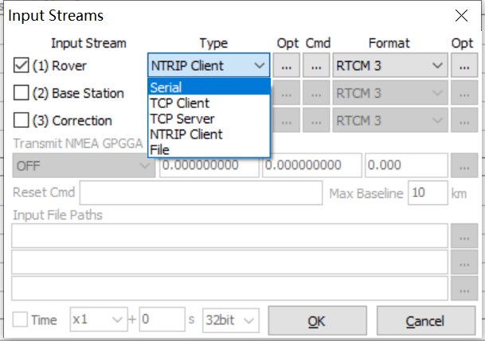
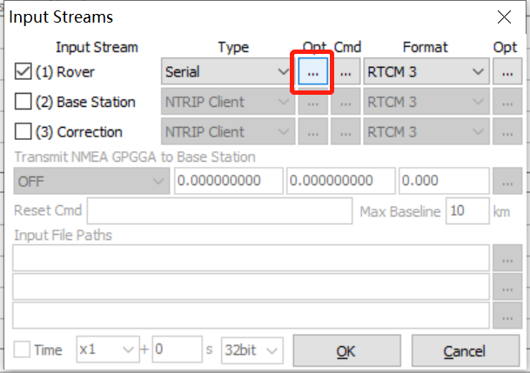
Set input stream parameter
Select “serial” in the type option.
Click the opt button to open the Serial Options dialog.

Slide 21
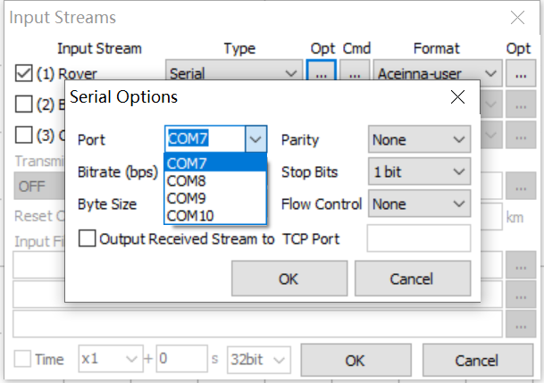
Set input stream parameter
Select the first serial port in the serial Options dialog.

Slide 22
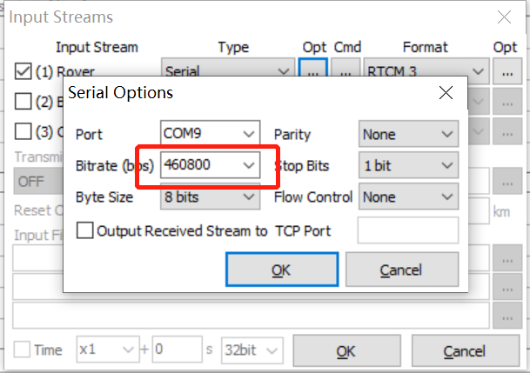
Set input stream parameter
Bitrate is selected as 460800.

Slide 23
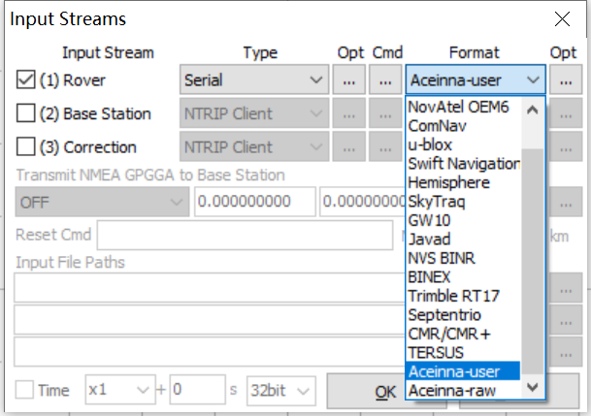
Set input stream parameter
Format is selected as Aceinna-user.

Slide 24
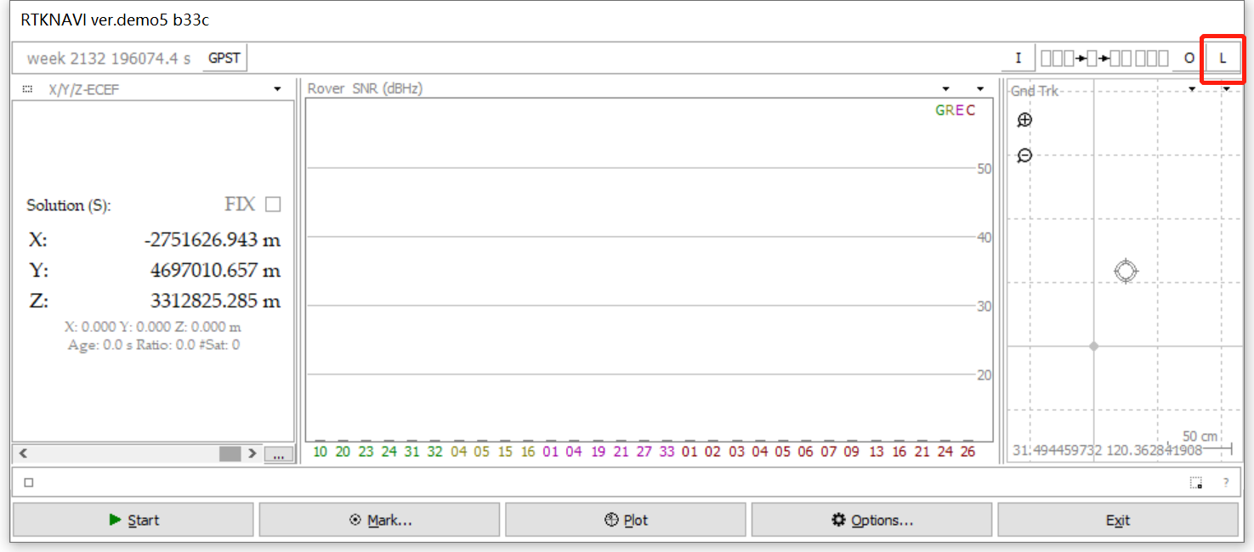
Set output log files path
Click the ‘L’ button to open Log Streams dialog.

Slide 25
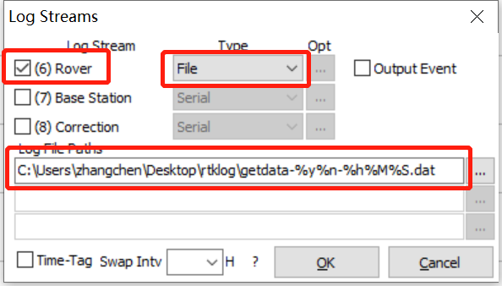
Set output log files path
Check (6)Rover ,select File type and input the log file paths. Click OK button.

Slide 26
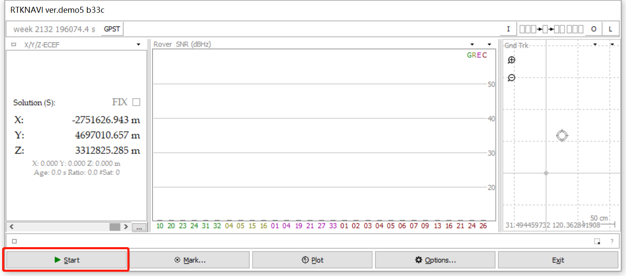
Start to receive data
Click the start button to start receiving the data.

Slide 27
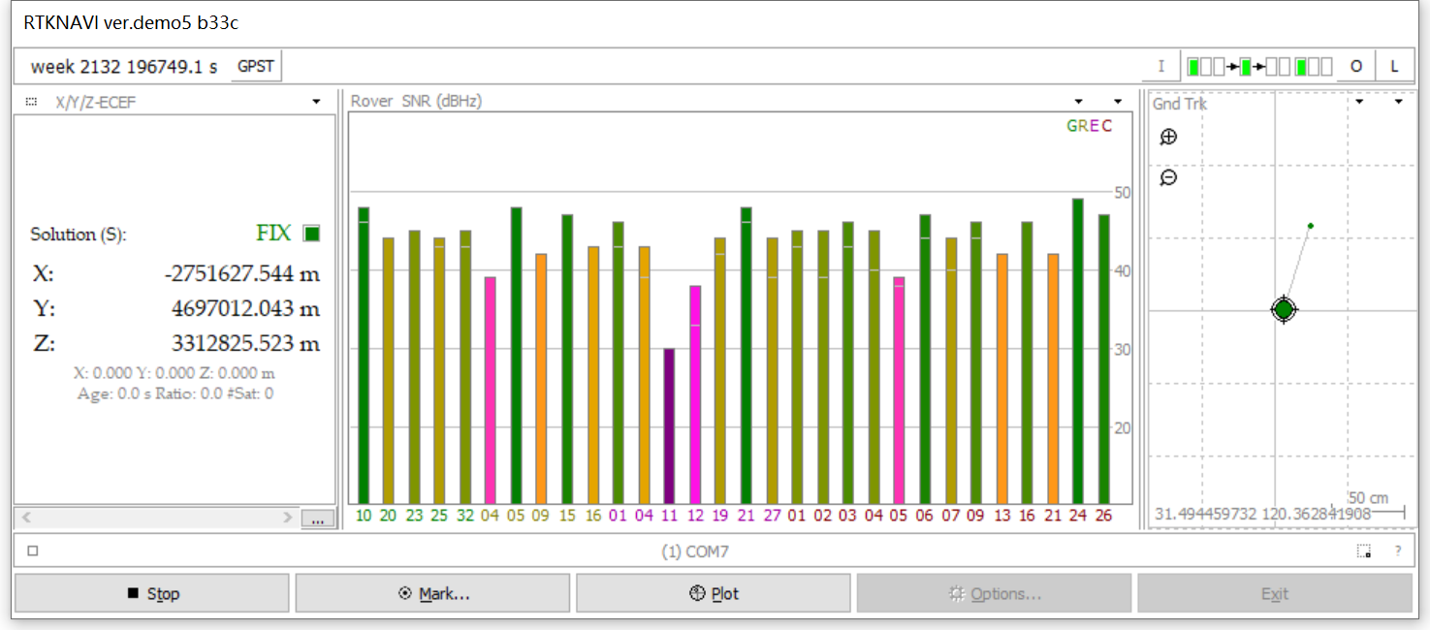
Start to receive data
When receiving the data, the SNR bar is plotted. Click the arrow button to switch view (SNR bar, sky map, positioning coordinates, horizontal error scatter, position error timeseries in north, east and up).

Slide 28
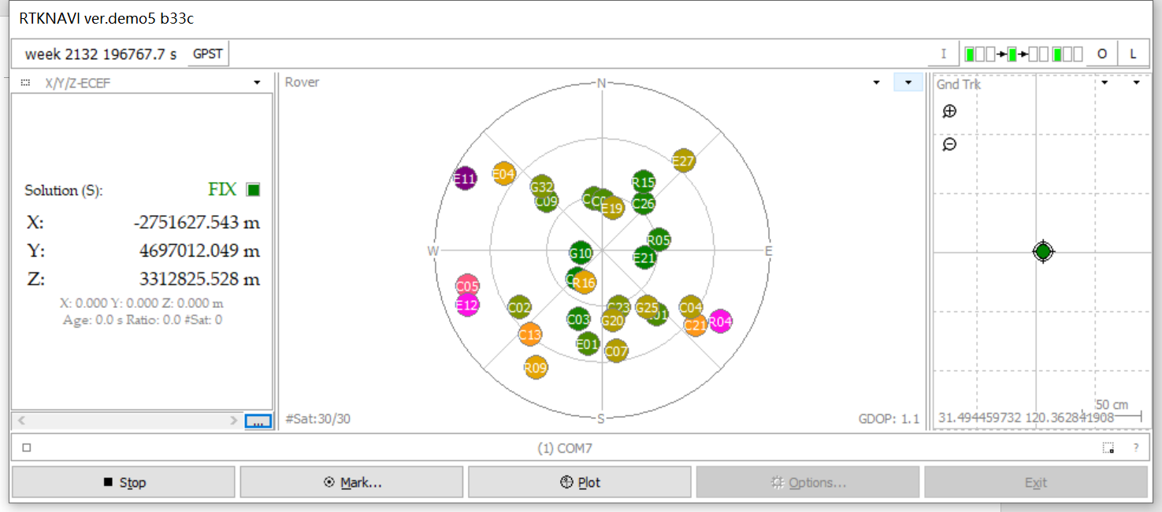
Start to receive data
The sky map.

Slide 29
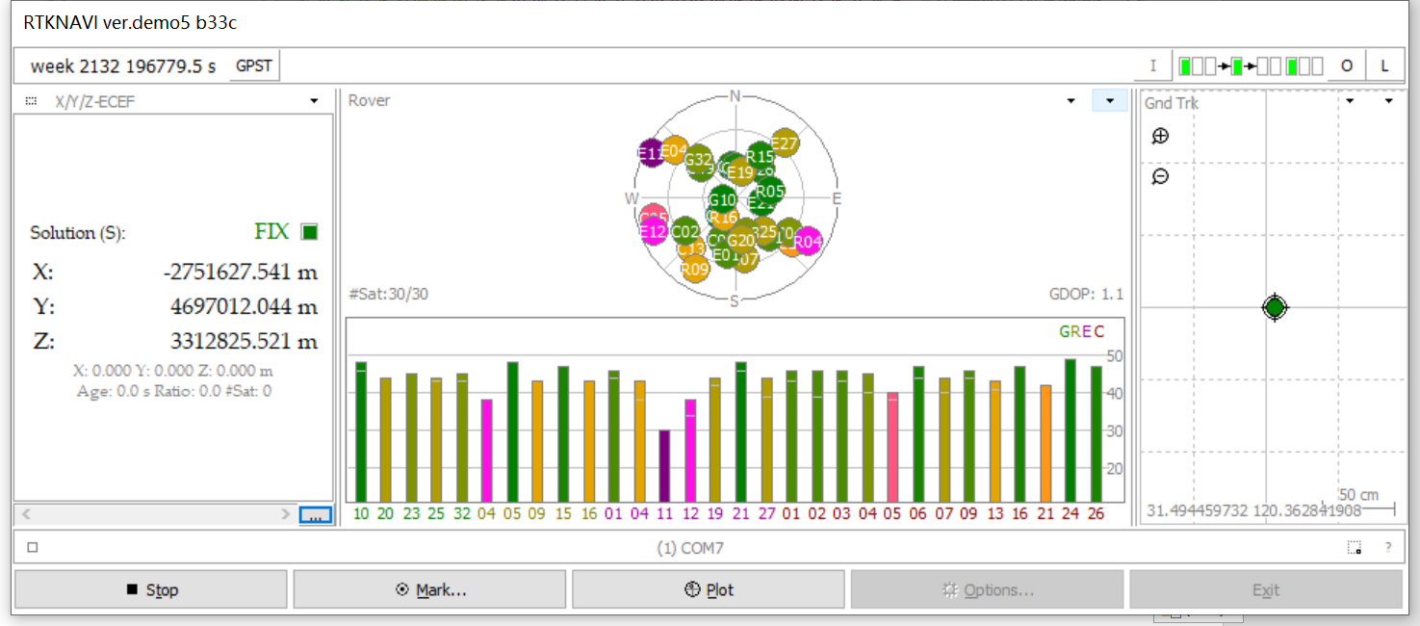
Start to receive data
Both sky map and SNR plot.

Slide 30
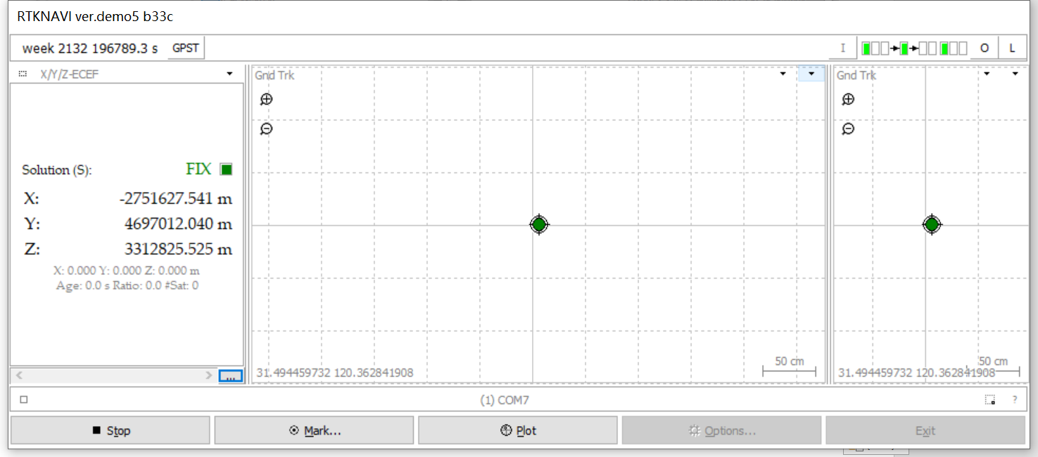
Start to receive data
The Gnd Trk.

Slide 31
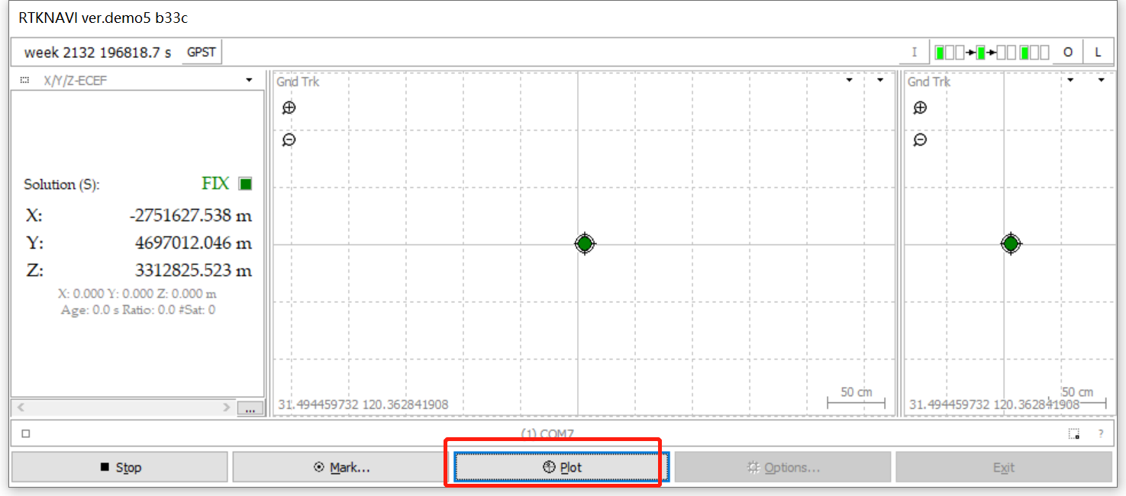
Start to receive data
Click the Plot button to open RTKPLOT.

Slide 32
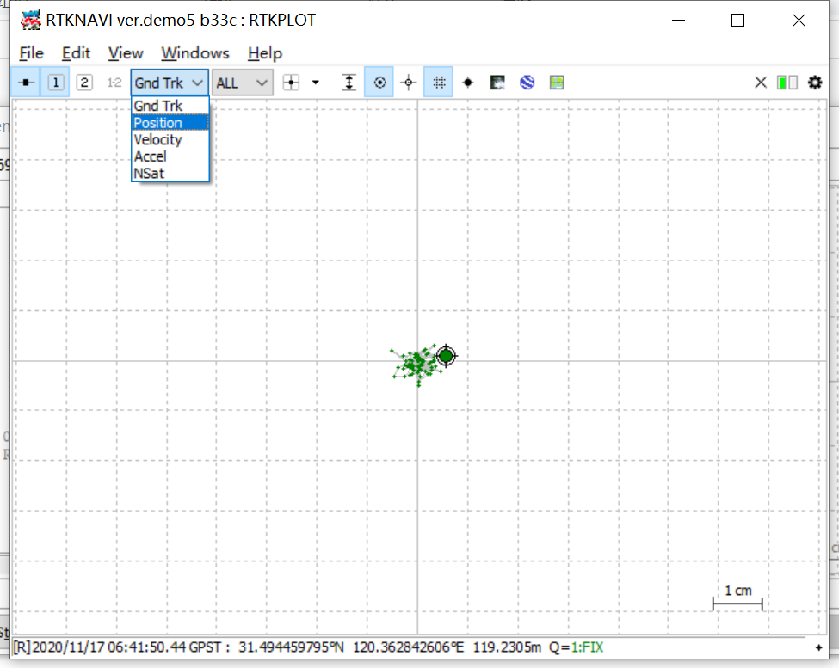
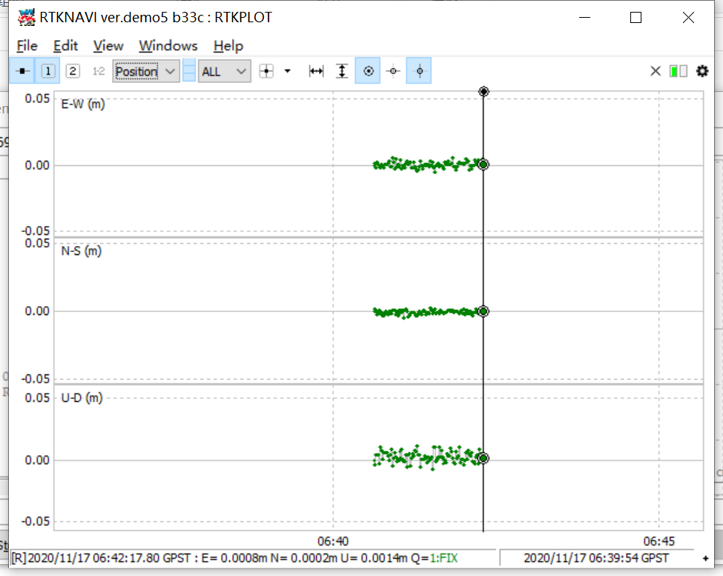
Start to receive data
The RTKPLOT dialog. Select the drop-down list to switch views. The Position error time series are plotted.

Slide 33
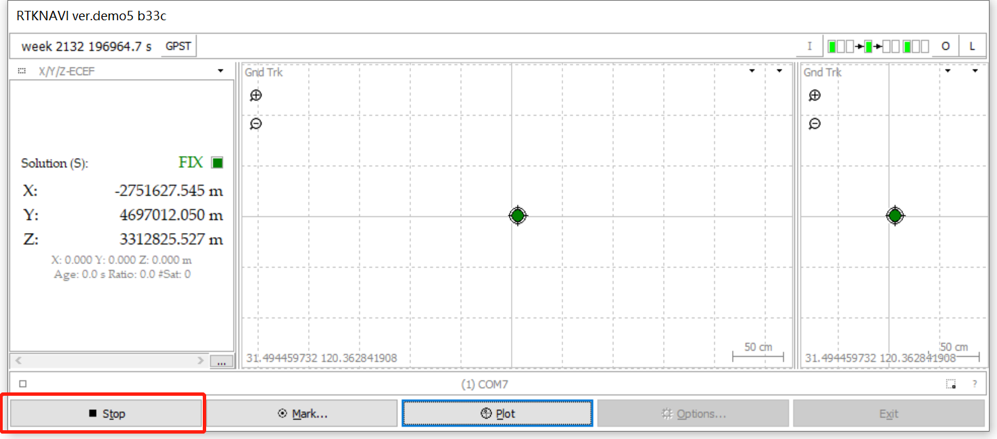
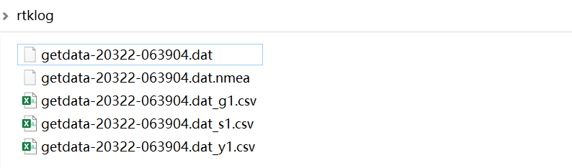
Start to receive data
Click Stop button to stop receiving data. The output file is saved in the selected output path.

Slide 34
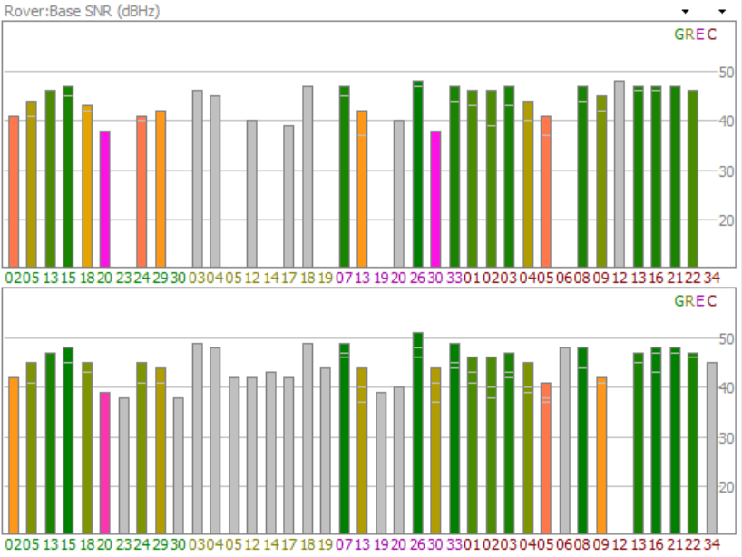
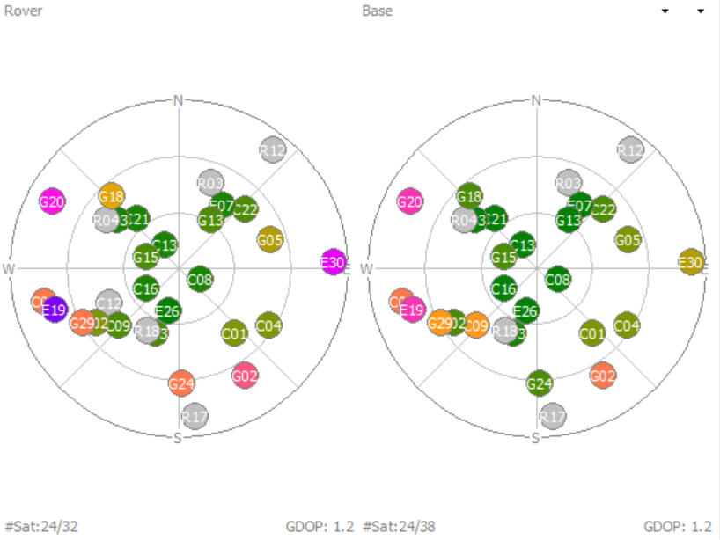
Use RTKLIBNAVI to decode aceinna-raw data
Aceinna-raw data contains the original data of rover station and base station. Using rtklibnavi to connect the third serial port of openrtk330, the rover station and the base station information can be read at the same time. These data can be displayed by SNR plot, sky map, baseline and GND Trk. At the same time, these data can also be used for RTK processing.

Slide 35
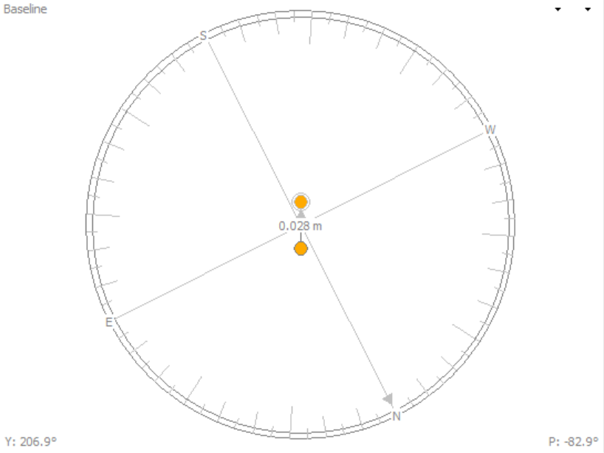
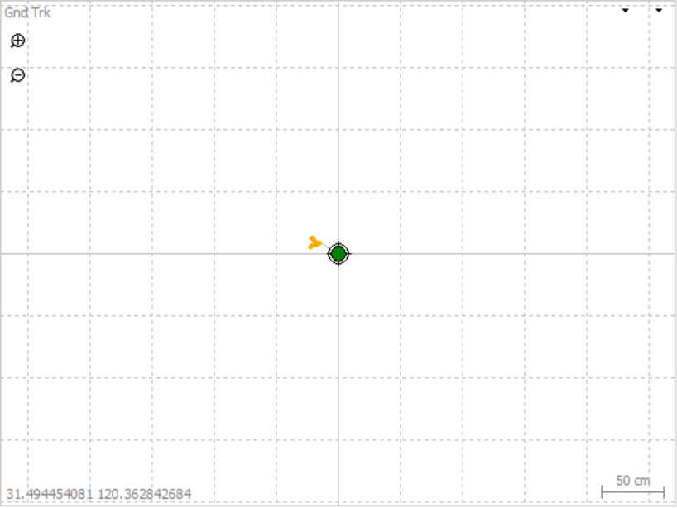
Use RTKLIBNAVI to decode aceinna-raw data
SNR plot, star map, baseline and GND Trk

Slide 36
Set input stream parameter
Click the ‘I’ button to open Input Streams dialog.

Slide 37
Set input stream parameter
Check (1) Rover in the Input Streams dialog.

Slide 38
Set input stream parameter
Select serial in the type option.

Slide 39
Set input stream parameter
Click the opt button to open the Serial Options dialog.

Slide 40
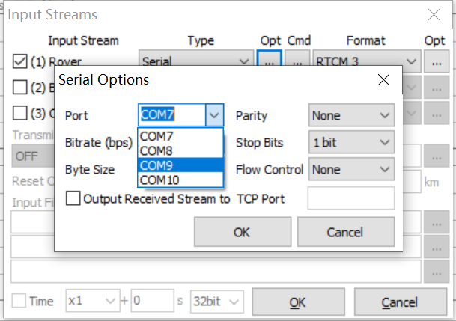
Set input stream parameter
Select the third serial port in the serial Options dialog.

Slide 41
Set input stream parameter
Bitrate is selected as 460800.

Slide 42
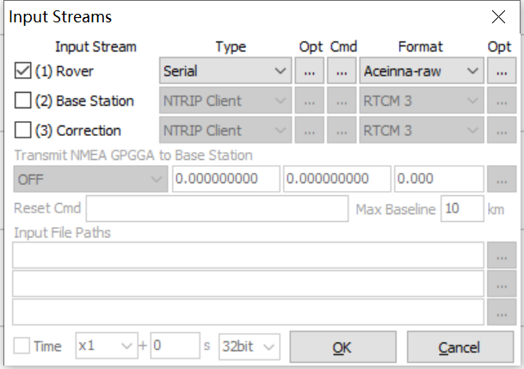
Set input stream parameter
Format is selected Aceinna-raw.

Slide 43
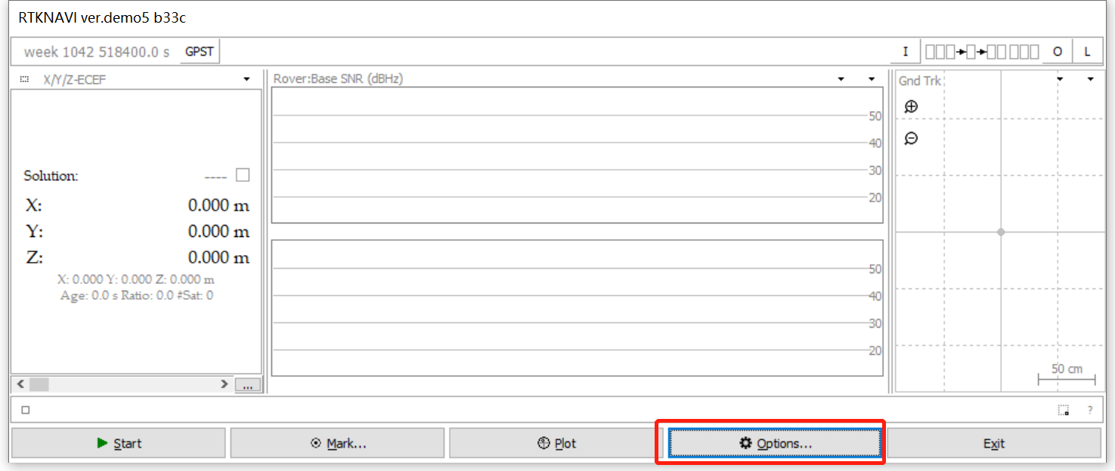
RTK processing config
Close the Input Streams dialog and click the options button to open the options dialog.

Slide 44
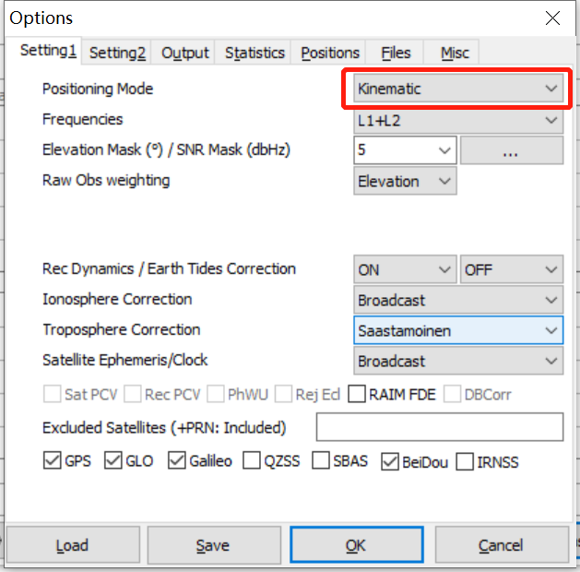
RTK processing config
In the options dialog, choose the RTK posting mode option as “kinematic” or “static”.

Slide 45
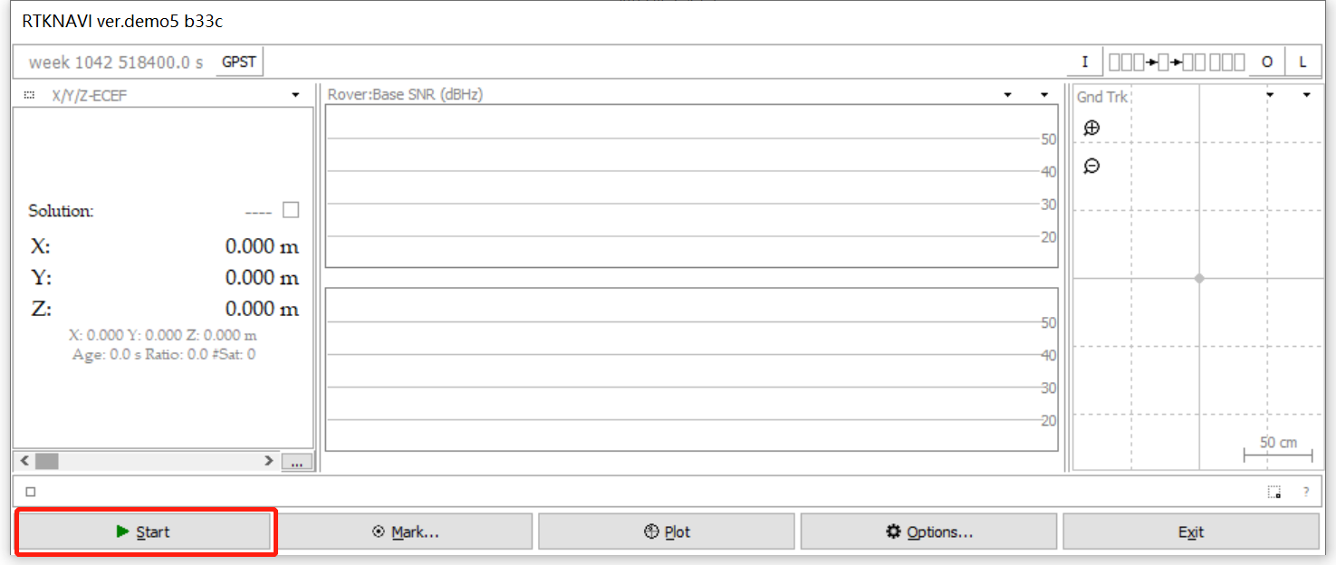
Start to receive data
Click the start button to start receiving the data.

Slide 46
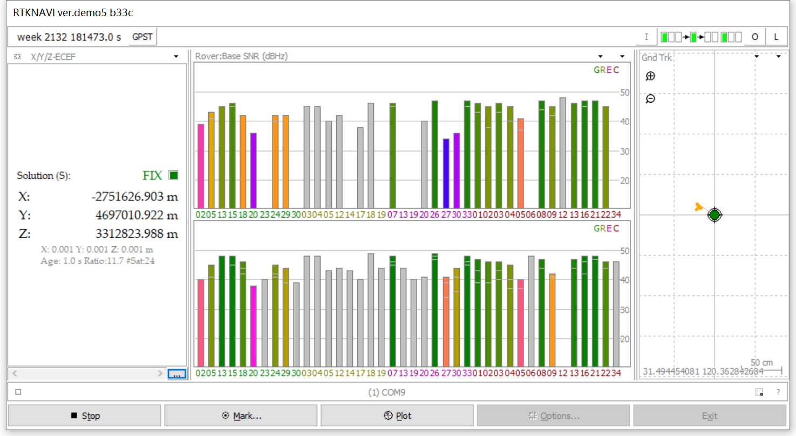
Start to receive data
When receiving the data, the SNR map of Rover and base according to the data will appear in GUI, and RTK results will be displayed.

Slide 47
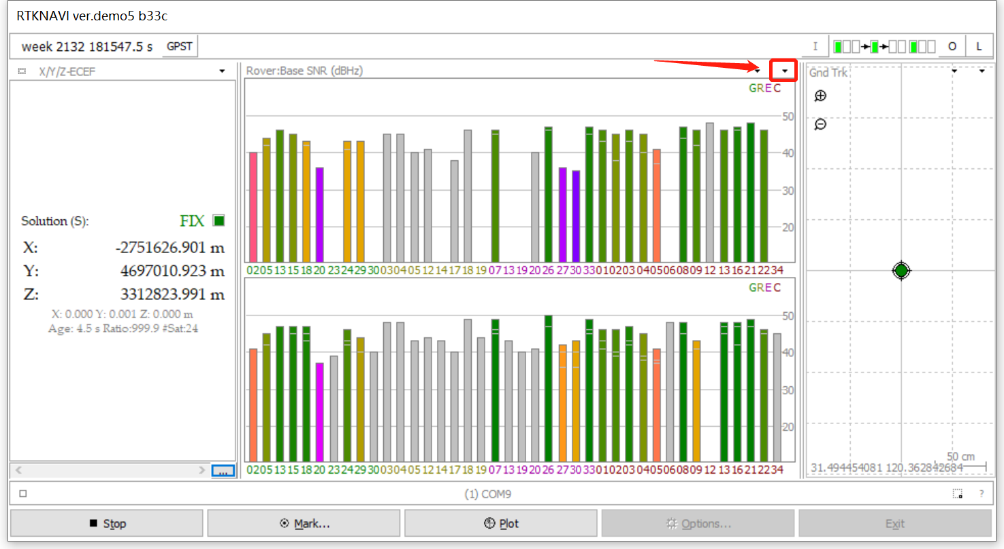
Start to receive data
Click the arrow button to switch view(SNR bar, sky map, positioning coordinates, baseline, horizontal error scatter, position error timeseries in north, east and up).

Slide 48
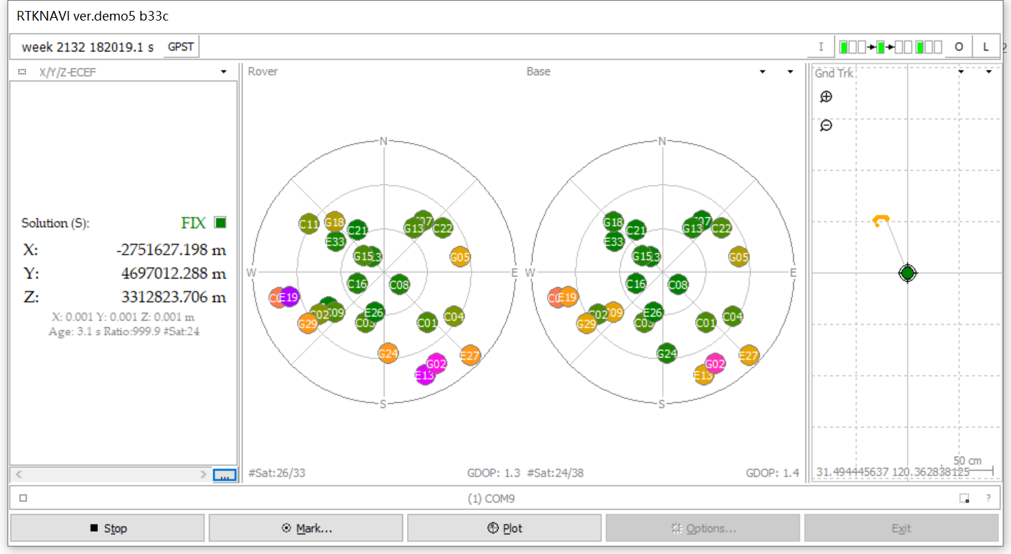
Start to receive data
The sky maps.

Slide 49
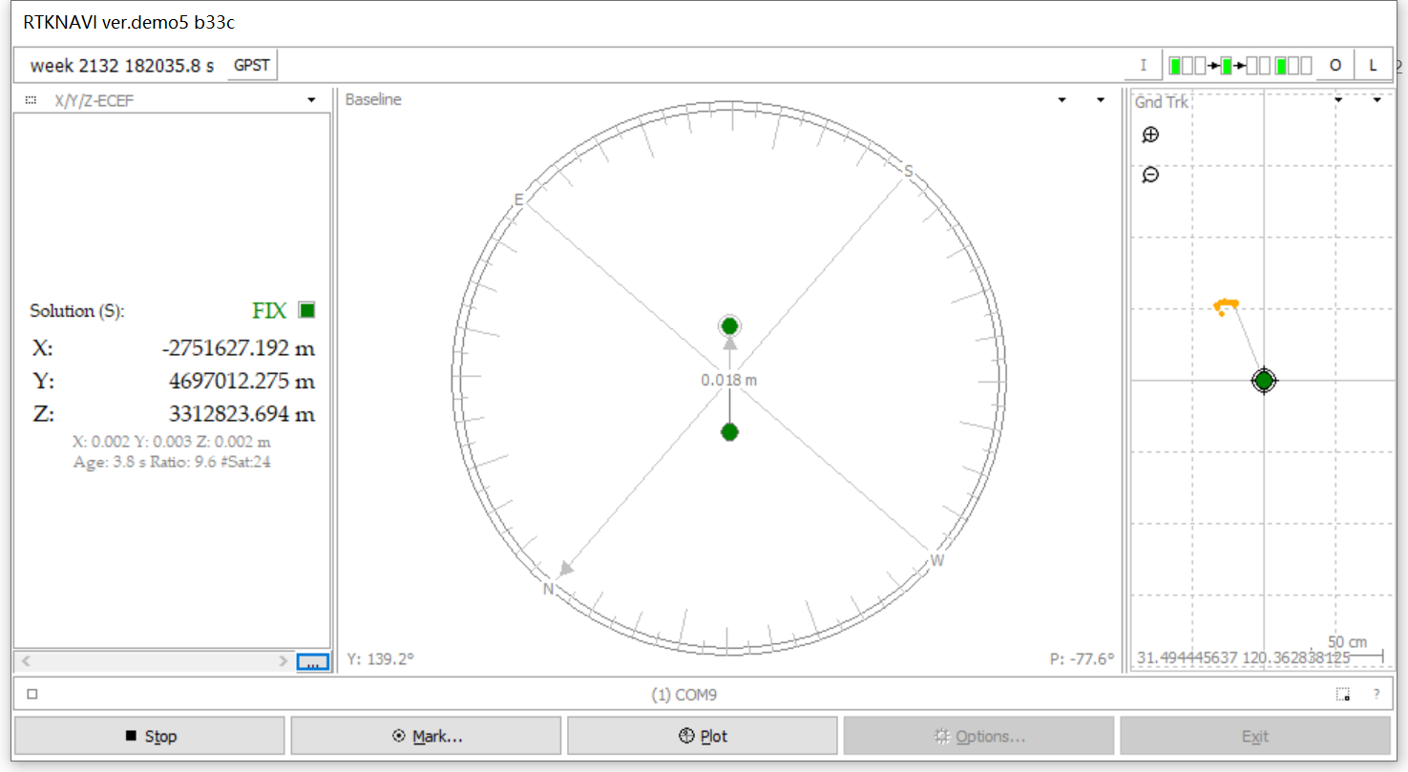
Start to receive data
The baseline.

Slide 50
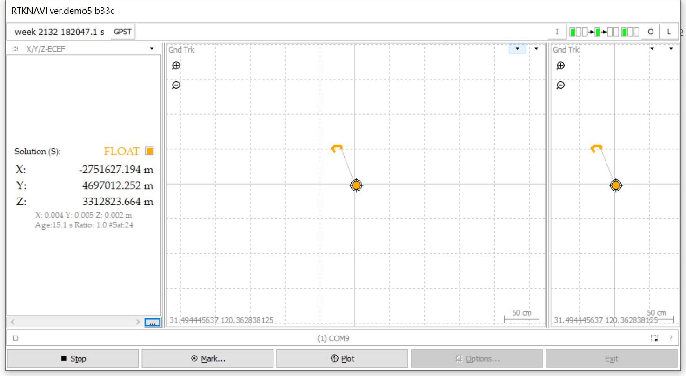
Start to receive data
The Gnd Trk.

Slide 51
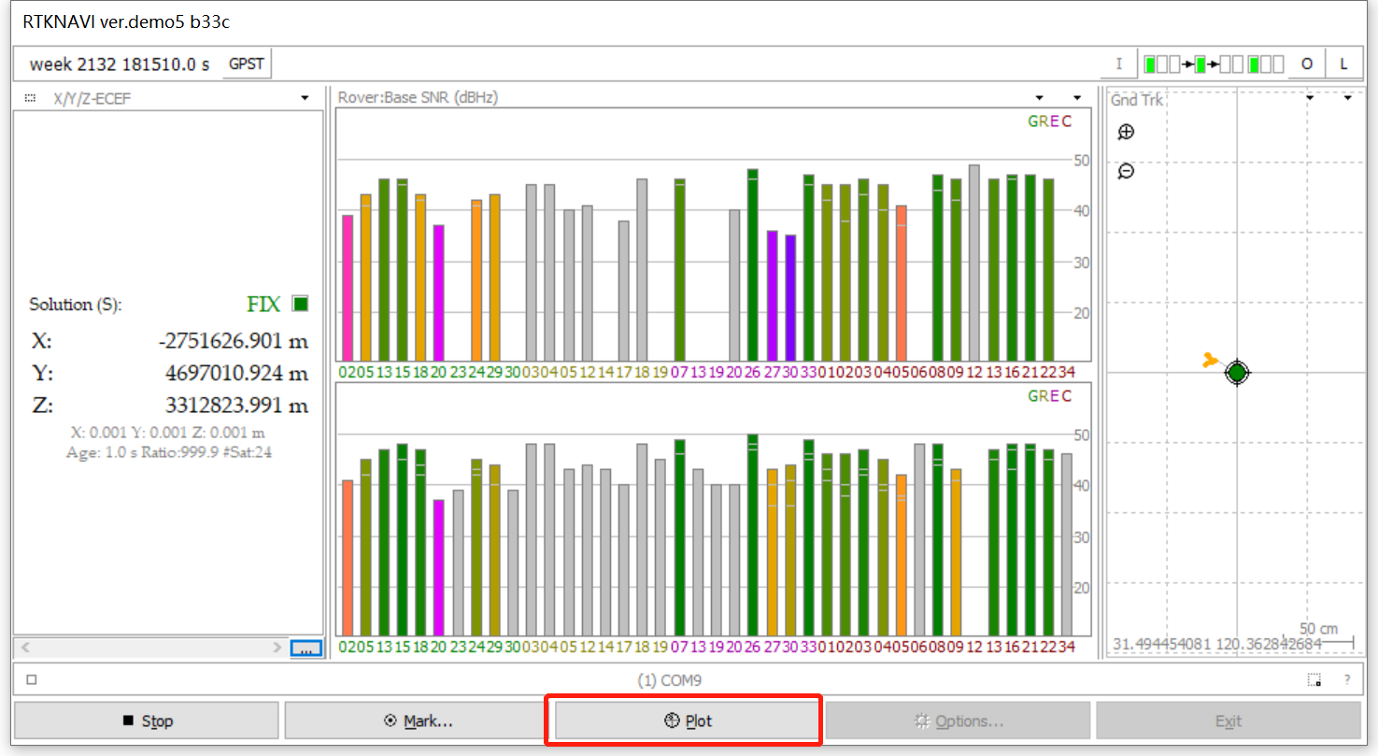
Start to receive data
Click the Plot button to Open RTKPLOT.

Slide 52
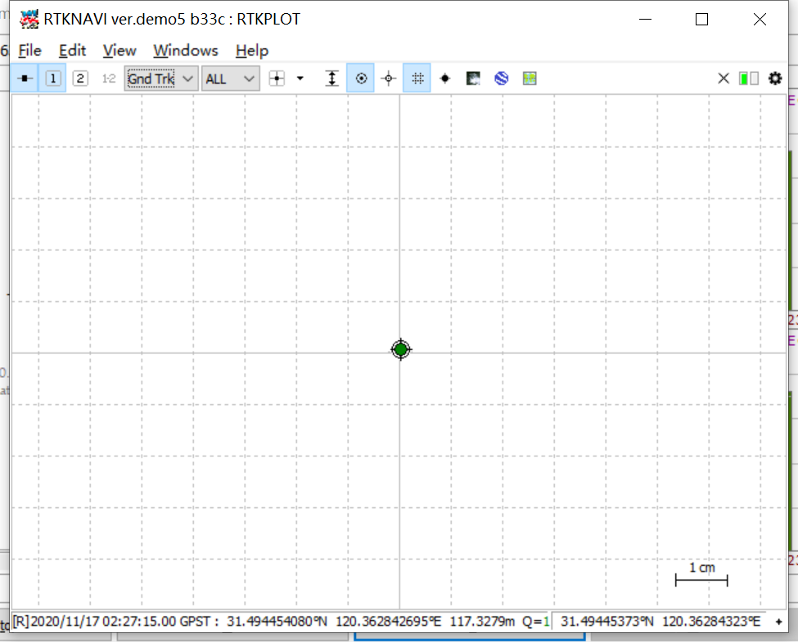
Start to receive data
The RTKPLOT dialog.

Slide 53
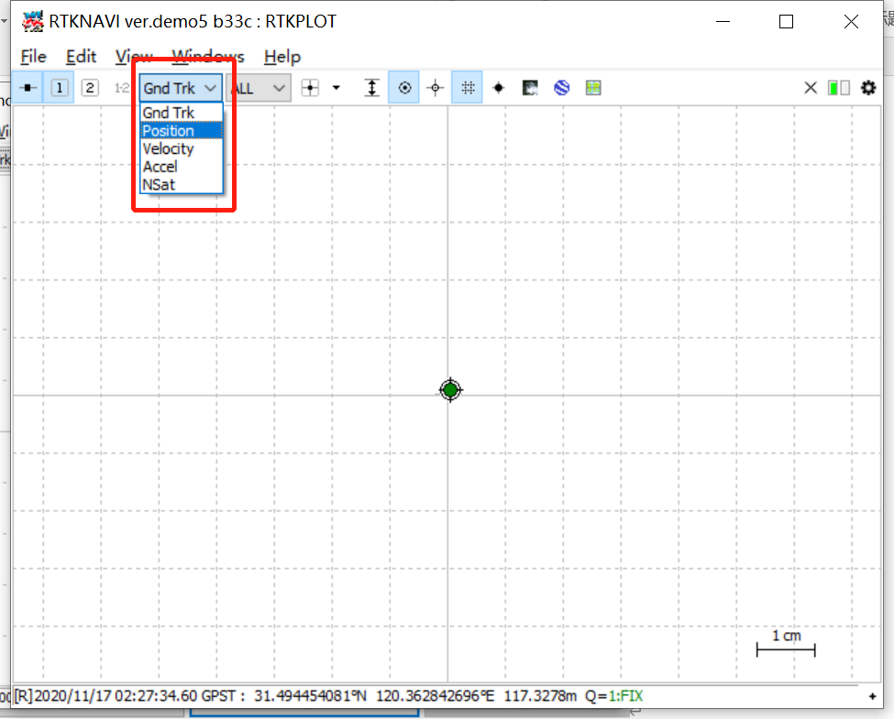
Start to receive data
Select the drop-down list to switch views.

Slide 54
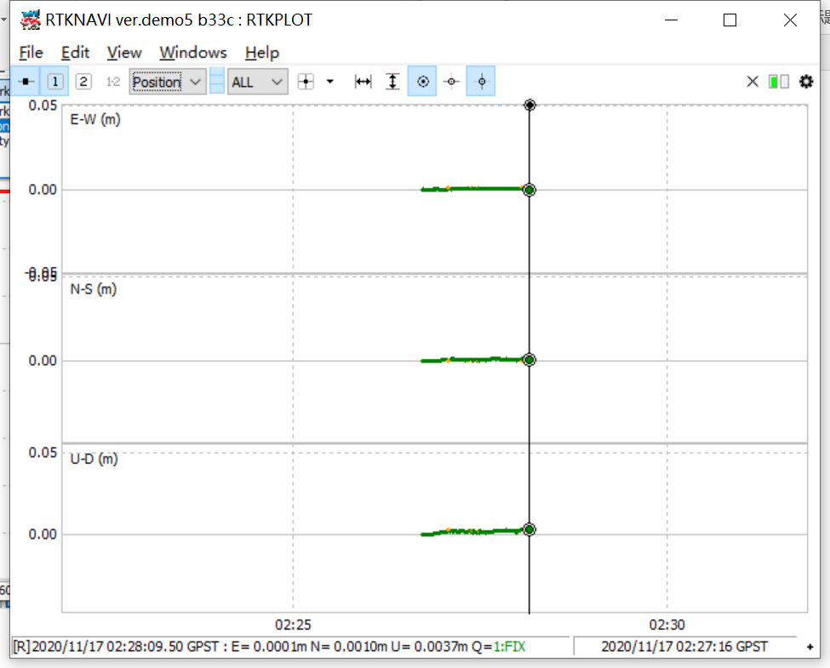
Start to receive data
The position error time series views.

Slide 55

Use RTKLIBNAVI to decode INS2000 data and decode
Click the [i] button in the upper right corner to open the [input streams] dialog box.

Slide 56

Check [(1) Rover], select [serial] for [type], select [ins2000] for [format], and click [Opt] to open the [serial options] dialog box.

Slide 57

[port] select the serial port of ins2000, and [bitrate] select 460800. Click [OK] to close the dialog box.

Slide 58

Click the [l] button in the upper right corner to open the [log streams] dialog box.

Slide 59

Check [(6) Rover], [type] select [file], and then select a path to save the file, and click [OK] to close the dialog box.

Slide 60


Click [start] to start data collection and decoding.

